Slide 1
Chapter 14
The Social Survey case study

Slide 2
Objectives
Applied
Given the code in any cell or group of cells in the Social Survey case study, describe what it does.
Knowledge
Explain how you can work with the data in a Stata file that is so large that it can’t be imported into a DataFrame on your computer system.
Describe the problem that occurs in the Social Survey case study when you plot the responses for two different sample sizes, and describe the solution for that problem.

Slide 3
Download the zip file for the Social Survey
import pandas as pd
import seaborn as sns
import pyreadstat
from urllib import request
from zipfile import ZipFile
zip_url = \
'http://gss.norc.org/Documents/stata/gss_stata_with_codebook.zip'
request.urlretrieve(zip_url, filename='gss_stata_with_codebook.zip')

Slide 4
Unzip the file
with ZipFile('gss_stata_with_codebook.zip', mode='r') as zip:
zip.extractall()
for file in zip.infolist():
print(f'{file.filename:25} - {file.file_size:15,d} Bytes')
==================================================================
Release Notes 7218.pdf - 296,746 Bytes
GSS_Codebook.pdf - 37,952,897 Bytes
GSS7218_R3.DTA - 449,140,819 Bytes

Slide 5
Extract the metadata using the pyreadstat module
gss_empty, gss_meta = pyreadstat.read_dta('GSS7218_R3.DTA', metadataonly=True)
print('Number of columns: ', gss_meta.number_columns)
print('Number of rows: ', gss_meta.number_rows)
=====================================================
Number of columns: 6110
Number of rows: 64814

Slide 6
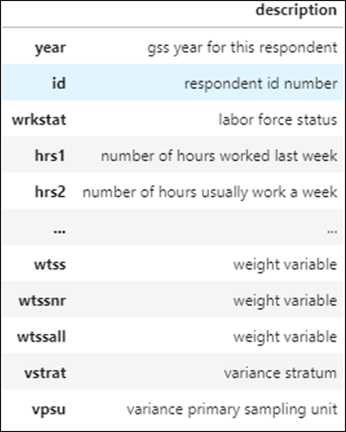
Build a DataFrame of column names and descriptions
meta_cols=pd.DataFrame(data=gss_meta.column_labels,
index=gss_meta.column_names,
columns=['description'])
meta_cols

Slide 7
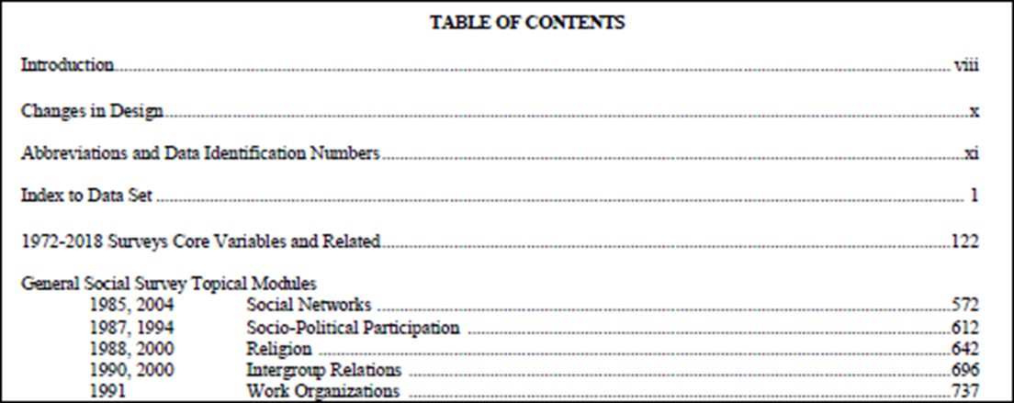
The table of contents for the codebook

Slide 8
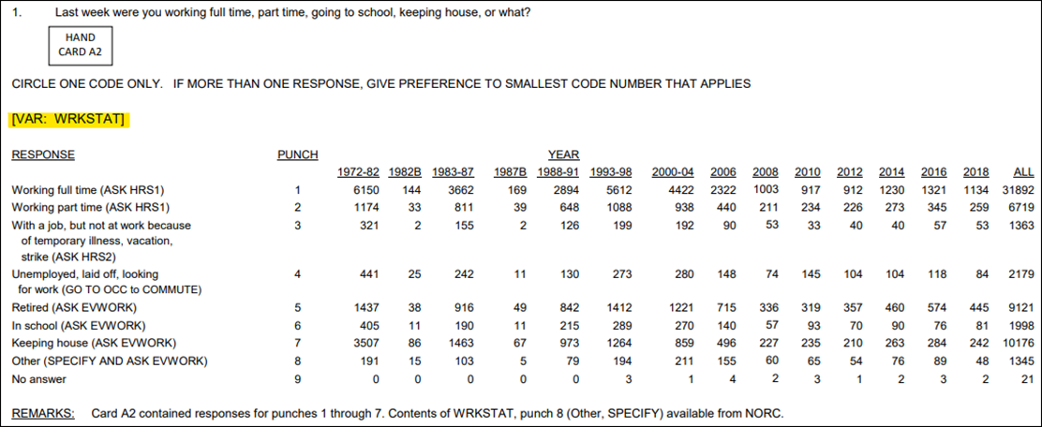
The documentation for a survey question

Slide 9
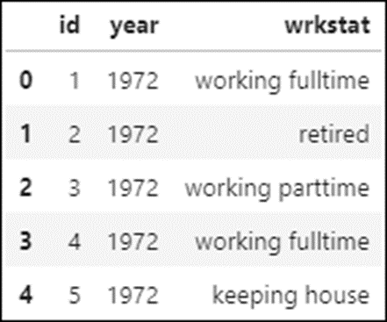
Load the data for the wrkstat question into a DataFrame
workStatus = pd.read_stata('GSS7218_R3.DTA',
columns=['id','year','wrkstat'])
workStatus.head()

Slide 10
View the data types of the columns
workStatus.info()
=====================================
Data columns (total 3 columns):
# Column Non-Null Count Dtype
--- ------ -------------- -----
0 id 64814 non-null int16
1 year 64814 non-null int16
2 wrkstat 64793 non-null category
dtypes: category(1), int16(2)
memory usage: 823.2 KB

Slide 11
Check the work status data for missing responses
workStatus['wrkstat'].value_counts(dropna=False)
===================================================
working fulltime 31892
keeping house 10176
retired 9121
working parttime 6719
unempl, laid off 2179
school 1998
temp not working 1363
other 1345
NaN 21
Name: wrkstat, dtype: int64

Slide 12
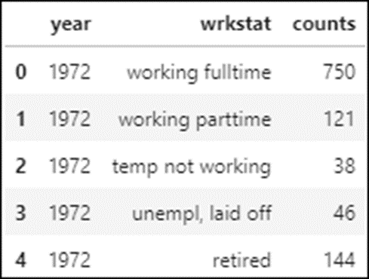
Add counts by year
statusCounts = workStatus.groupby(
by=['year','wrkstat'], as_index=False).count()
statusCounts.columns = ['year', 'wrkstat', 'counts']
statusCounts.head()

Slide 13
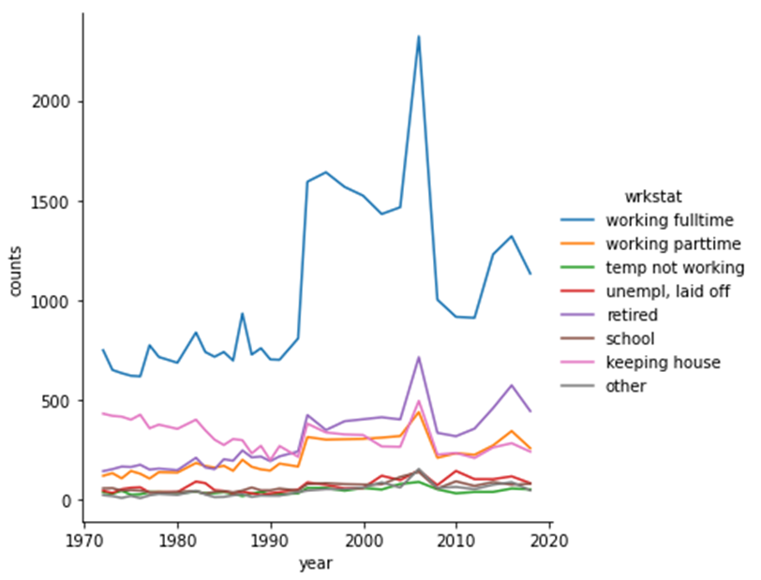
Plot the wrkstat data
sns.relplot(data=statusCounts, x='year', y='counts',
hue='wrkstat', kind='line')

Slide 14
Reduce the number of plotted categories
statusCountsTop = statusCounts.query(
'wrkstat in ["working fulltime", "working parttime",
"retired", "unempl, laid off"]').copy()

Slide 15
The categories after filtering
statusCountsTop.wrkstat.value_counts()
=======================================
retired 32
unempl, laid off 32
working parttime 32
working fulltime 32
other 0
keeping house 0
school 0
temp not working 0
Name: wrkstat, dtype: int64

Slide 16
Remove unused categories
statusCountsTop.wrkstat = \
statusCountsTop.wrkstat.cat.remove_unused_categories()
statusCountsTop.wrkstat.value_counts()
==========================================================
retired 32
unempl, laid off 32
working parttime 32
working fulltime 32
Name: wrkstat, dtype: int64

Slide 17
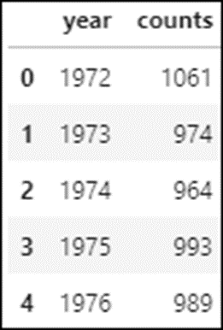
Count the total number of responses by year
topCountsByYear = topCounts.groupby(by=['year'],
as_index=False).sum()
topCountsByYear.head()

Slide 18
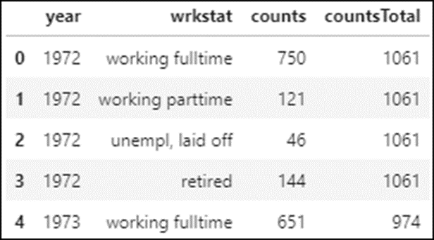
Merge the topCountsByYear DataFrame with the topCounts DataFrame
topCounts = topCounts.merge(topCountsByYear, on='year',
suffixes=('','Total'))
topCounts.head()

Slide 19
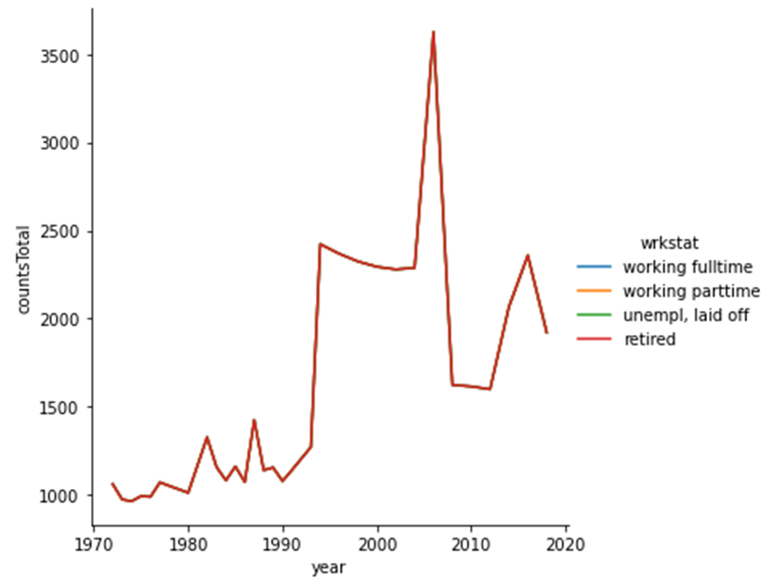
Plot the total count of responses
sns.relplot(data=topCounts, x='year', y='countsTotal',
kind='line')

Slide 20
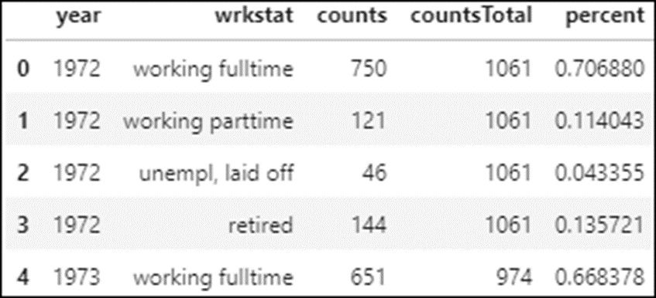
Convert each measurement to a percentage of the total
topCounts['percent'] = topCounts.counts / topCounts.countsTotal
topCounts.head()

Slide 21
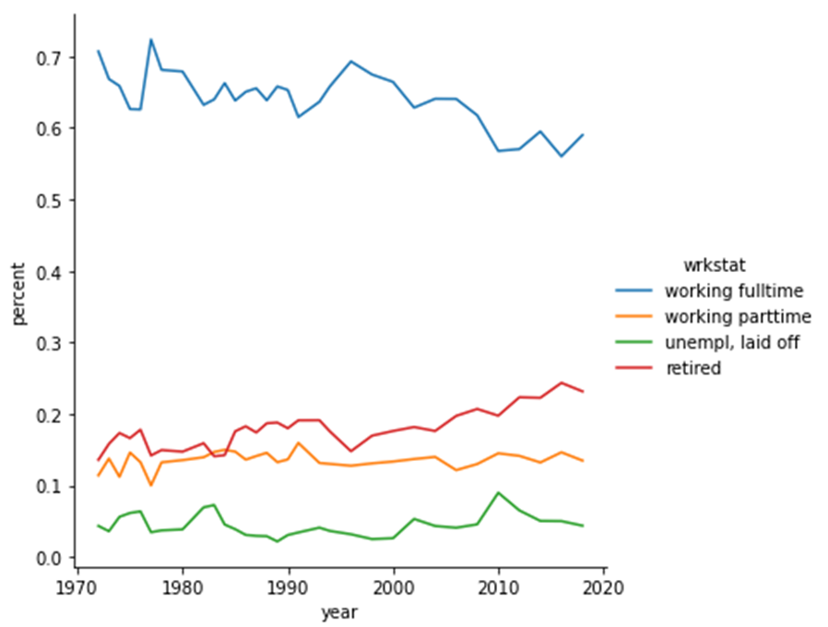
Plot the percentage data
sns.relplot(data=topCounts, x='year', y='percent',
kind='line', hue='wrkstat', palette='colorblind')

Slide 22
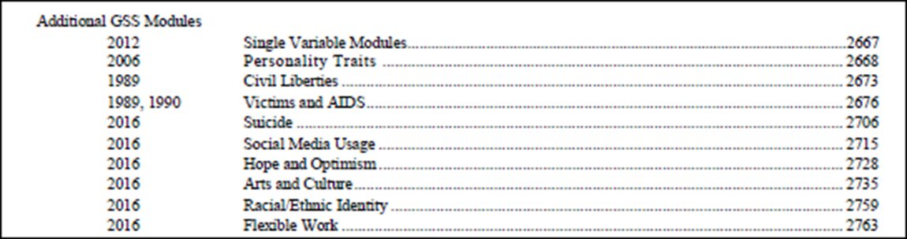
Search the TOC for small question sets

Slide 23
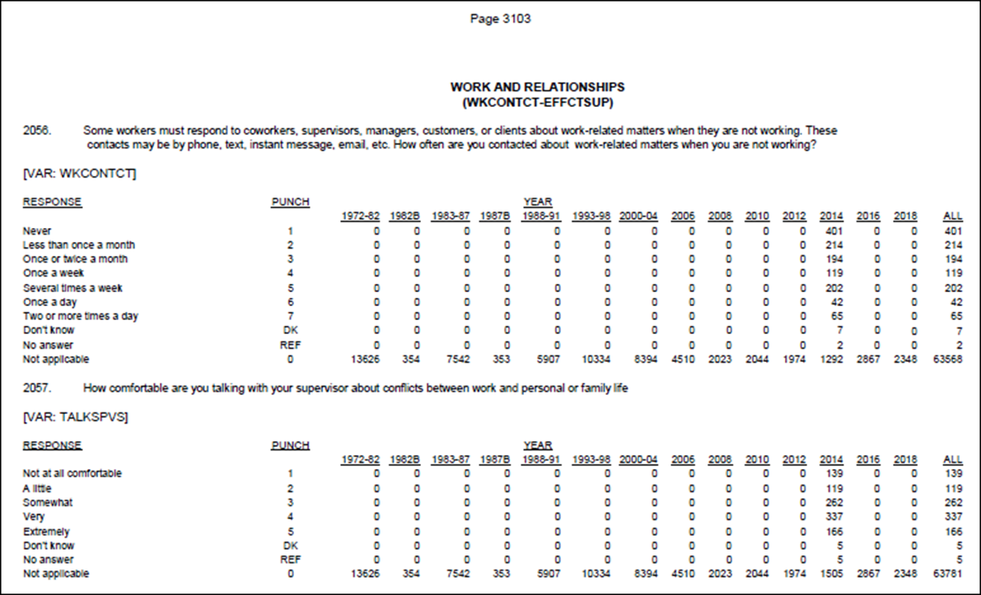
The first two questions in the Work and Relationships set

Slide 24
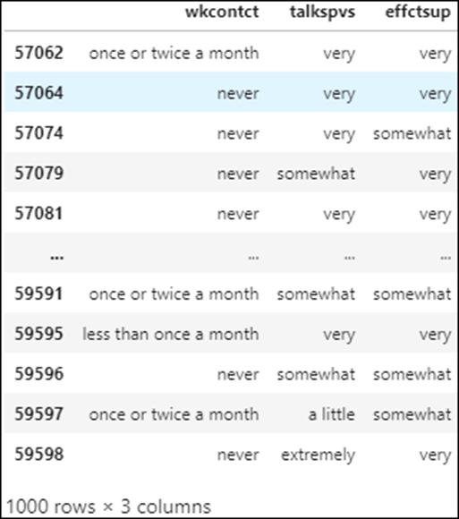
Read the work-life balance data
wlBalanceCols = ['wkcontct','talkspvs','effctsup']
wlBalance = pd.read_stata('GSS7218_R3.DTA',
columns=wlBalanceCols).dropna()
wlBalance

Slide 25
Identify the response values for each question
wlBalance.wkcontct.value_counts()
=================================
never 329
less than once a month 187
once or twice a month 170
several times a week 145
once a week 98
two or more times a day 42
once a day 29
Name: wkcontct, dtype: int64
wlBalance.talkspvs.value_counts()
=================================
very 333
somewhat 259
extremely 165
not at all comfortable 127
a little 116
Name: talkspvs, dtype: int64

Slide 26
Identify the response values (continued)
wlBalance.effctsup.value_counts()
=================================
very 338
somewhat 287
a little 158
extremely 125
not at all effective 92
Name: effctsup, dtype: int64

Slide 27
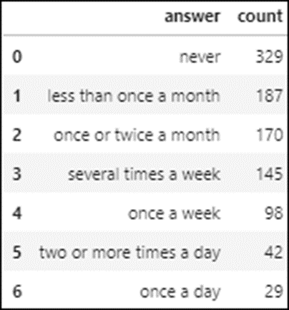
Prepare the data for the wkcontct question
workContact = \
wlBalance.wkcontct.value_counts().to_frame().reset_index()
workContact.columns = ['answer','count']
workContact

Slide 28
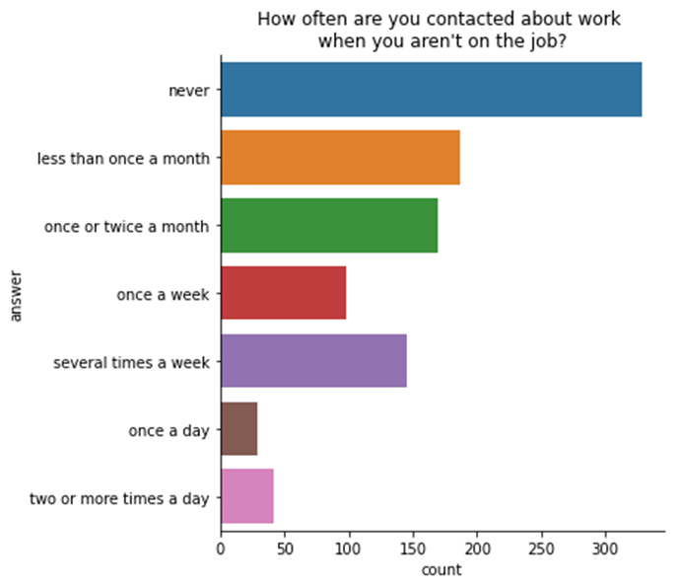
Plot the data for the wkcontct question
g = sns.catplot(data=workContact, x='count', y='answer',
kind='bar', orient='h', aspect=1.25)
g.set(title="How often are you contacted about work\n" +
"when you aren't on the job?")

Slide 29
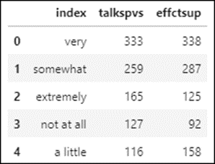
Prepare the data for plotting
Create DataFrames for the second and third questions
df1 = wlBalance.talkspvs.value_counts().to_frame()
df1 = df1.rename(index={'not at all comfortable':'not at all'})
df2 = wlBalance.effctsup.value_counts().to_frame()
df2 = df2.rename(index={'not at all effective':'not at all'})
Join the DataFrames
supervisorData = df1.join(df2).reset_index()
supervisorData.head()
Melt the data in the combined DataFrame
supervisorData = pd.melt(supervisorData, id_vars='index',
value_vars=['talkspvs', 'effctsup'])
supervisorData.columns = ['answer','question','responseCount']

Slide 30
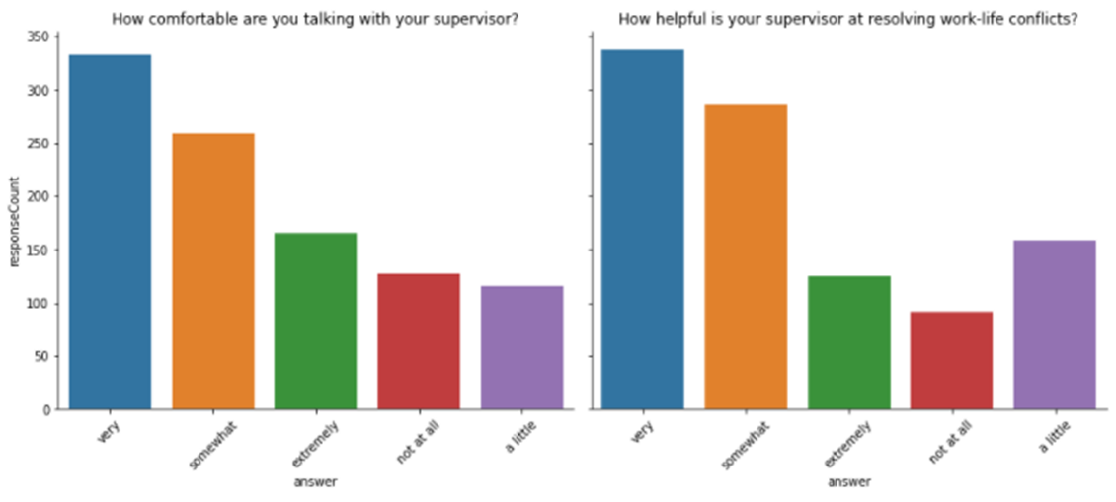
Plot the data for the questions
g = sns.catplot(data=supervisorData, x='answer', y='responseCount',
kind='bar', col='question', aspect=1.25, col_wrap=2)
titles = ['How comfortable are you talking with your supervisor?',
'How helpful is your supervisor at resolving work-life conflicts?']
for i, ax in enumerate(g.axes.flat):
ax.tick_params('x',labelrotation=45)
ax.set_title(titles[i])

Slide 31
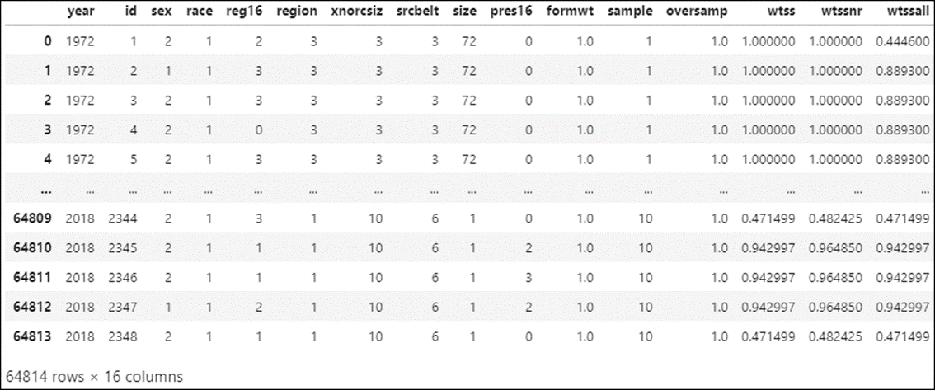
Read the entire dataset and find the columns with no missing values
allData = pd.read_stata('GSS7218_R3.DTA')
allData.dropna(axis=1)

Slide 32
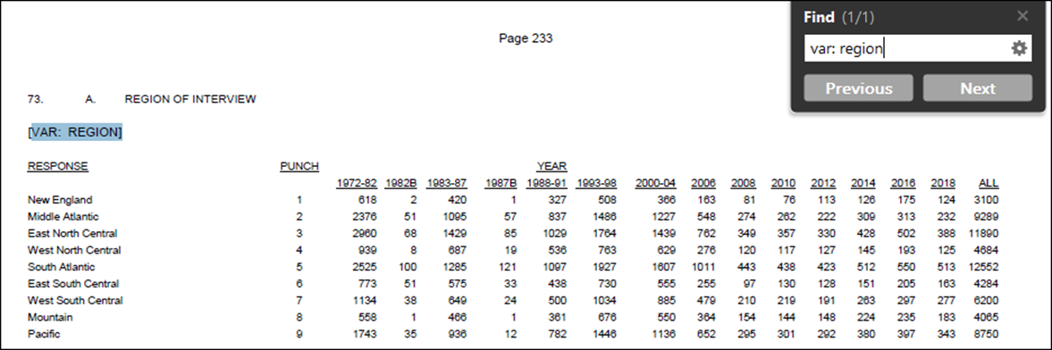
Search for the columns in the codebook

Slide 33
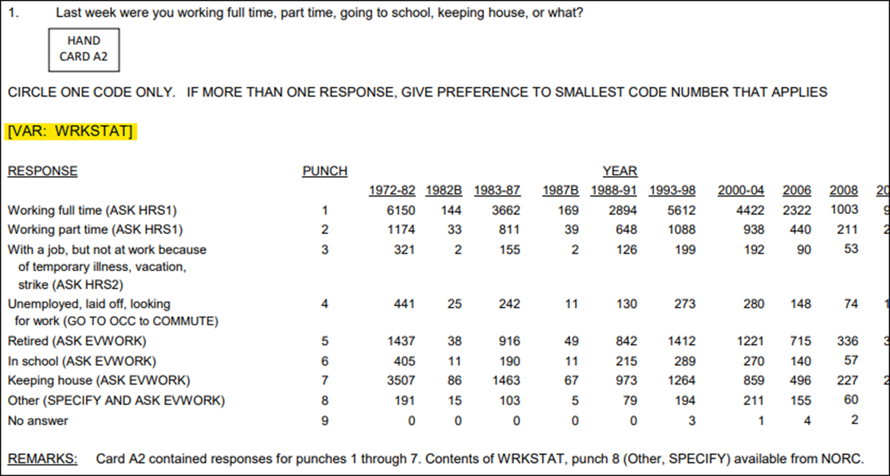
The WRKSTAT question

Slide 34
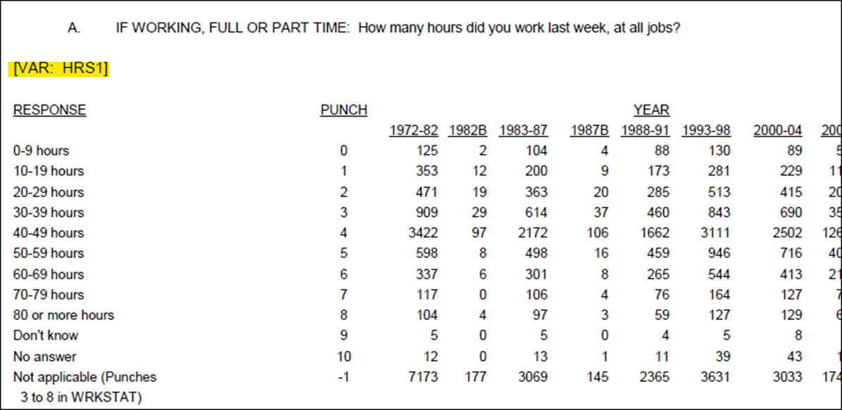
The HRS1 follow-up question

Slide 35
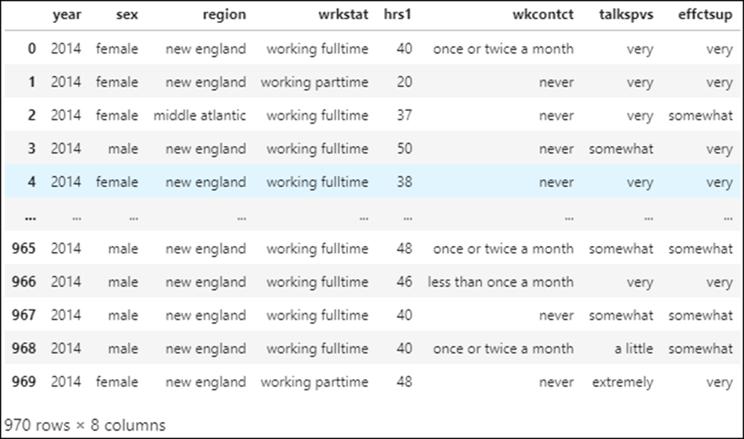
The expanded work dataset
workCols = ['year','sex','region','wrkstat','hrs1',
'wkcontct','talkspvs','effctsup']
workData = pd.read_stata('GSS7218_R3.DTA', columns=workCols) \
.dropna(axis=0).reset_index(drop=True)
workData

Slide 36
Identify missing data
workData.year.value_counts()
============================
2014 970
Name: year, dtype: int64

Slide 37
Find discrepancies between the codebook and the data
workData.hrs1.head()
====================
0 40
1 20
2 37
3 50
4 38
Name: hrs1, dtype: category
Categories (90, object): [0 < 1 < 2 < 3 ... 86 < 87 < 88 < '89+ hrs']

Slide 38
Prepare the data for binning
workData.hrs1. = workData.hrs1.astype(str).replace(
'89+ hrs','89').astype(float)
workData.hrs1.head()
===================================================
0 40.0
1 20.0
2 37.0
3 50.0
4 38.0
Name: hrs1, dtype: float64

Slide 39
Create the bin labels
binLabels = [f'{i}-{i+9} hours' for i in range(0,90,10)]
binLabels
========================================================
['0-9 hours',
'10-19 hours',
'20-29 hours',
'30-39 hours',
'40-49 hours',
'50-59 hours',
'60-69 hours',
'70-79 hours',
'80-89 hours']

Slide 40
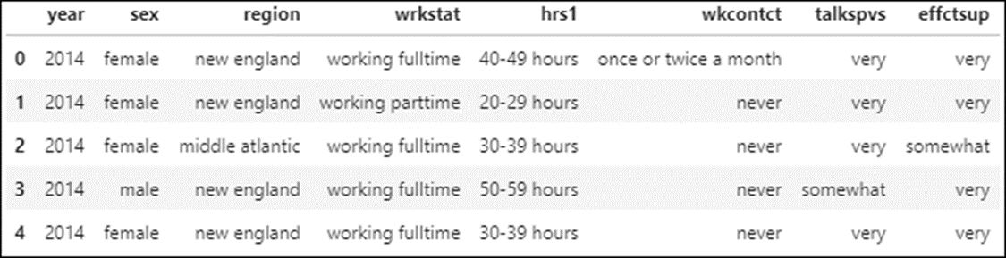
Bin the data
workData.hrs1 = pd.cut(workData.hrs1,
bins=[0,10,20,30,40,50,60,70,80,90],
right=False, labels=binLabels)
workData.head()

Slide 41
Characteristics of a good hypothesis
Specific
Clearly stated
Testable
Educated

Slide 42
The first hypothesis
Men are contacted on a daily basis for work reasons outside of working hours more often than women are.

Slide 43
Prepare the data
workData.sex.value_counts()
===========================
female 514
male 456
# drop 58 female respondents to get an equal number of male and female respondents
workData = workData.sort_values(
'sex', ascending=False).iloc[58:]

Slide 44
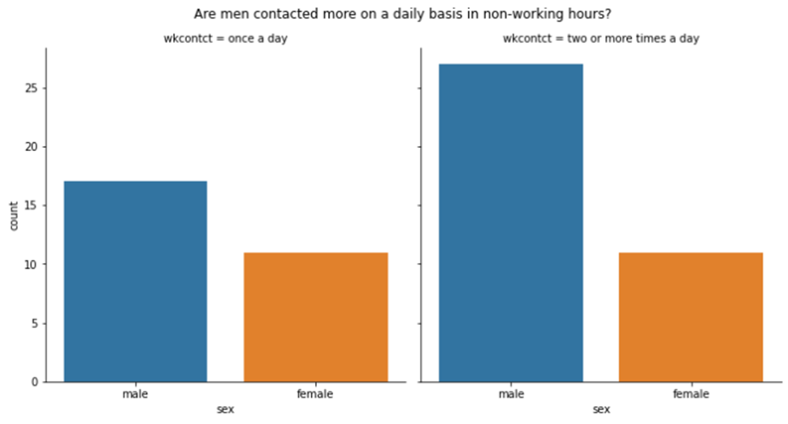
Test the first hypothesis
responses = ['once a day','two or more times a day']
df = workData.query('wkcontct in @responses').copy()
df.wkcontct = df.wkcontct.cat.remove_unused_categories()
g = sns.catplot(data=df, x='sex', col='wkcontct', kind='count')
g.fig.suptitle(
'Are men contacted more on a daily basis in non-working hours?',
y=1.035)

Slide 45
Conclusion for the first hypothesis
The results support the hypothesis. Men are contacted on a daily basis for work reasons outside of working hours more often than women are.

Slide 46
The second hypothesis
Respondents who are uncomfortable talking with their supervisors about conflicts between their work and their personal lives will work more hours than respondents who are comfortable with talking to their supervisors about conflicts between their work and their personal lives.

Slide 47
Test the second hypothesis
# create pivot table
workPivot = workData[['year','hrs1','talkspvs']].pivot_table(
columns='hrs1', index='talkspvs', aggfunc='count')
workPivot = workPivot.droplevel(0, axis=1) # the top column level
# isn’t needed
# create heatmap for pivot table
ax = sns.heatmap(workPivot, cmap='Blues', annot=True, fmt='.3g')
ax.set_title(
"Do those who don't like to talk with their supervisors " +
"work more hours?\n")
ax.set(xlabel='', ylabel='How comfortable talking with supervisor?')

Slide 48
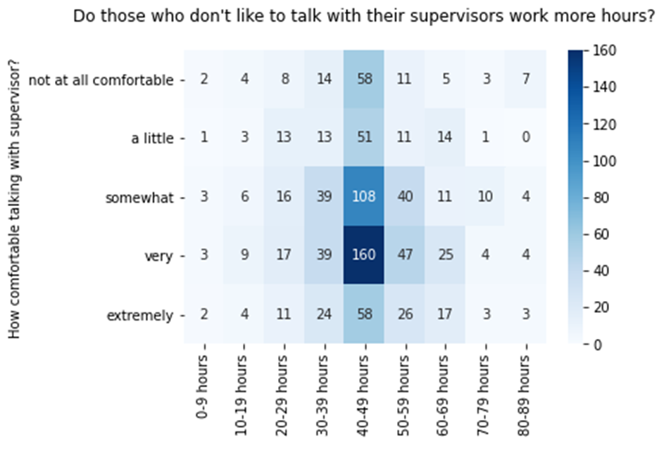
Test the second hypothesis (continued)

Slide 49
Conclusion for the second hypothesis
The data doesn’t support the hypothesis. The comfort level of the respondents when talking with their supervisors about work-life conflicts doesn’t have a significant effect on their weekly number of hours worked.

Slide 50
The third hypothesis
More women than men think their supervisors are effective when helping them resolve work-life conflicts.

Slide 51
Test the third hypothesis
responses = ['very','somewhat','extremely']
df = workData.query('effctsup in @responses').copy()
df.effctsup = df.effctsup.cat.remove_unused_categories()
g = sns.catplot(data=df, x='sex', col='effctsup', kind='count',
col_wrap=2)
g.fig.suptitle('How effective is your supervisor at helping you ' +
'resolve work-life conflicts?', y=1.025)

Slide 52
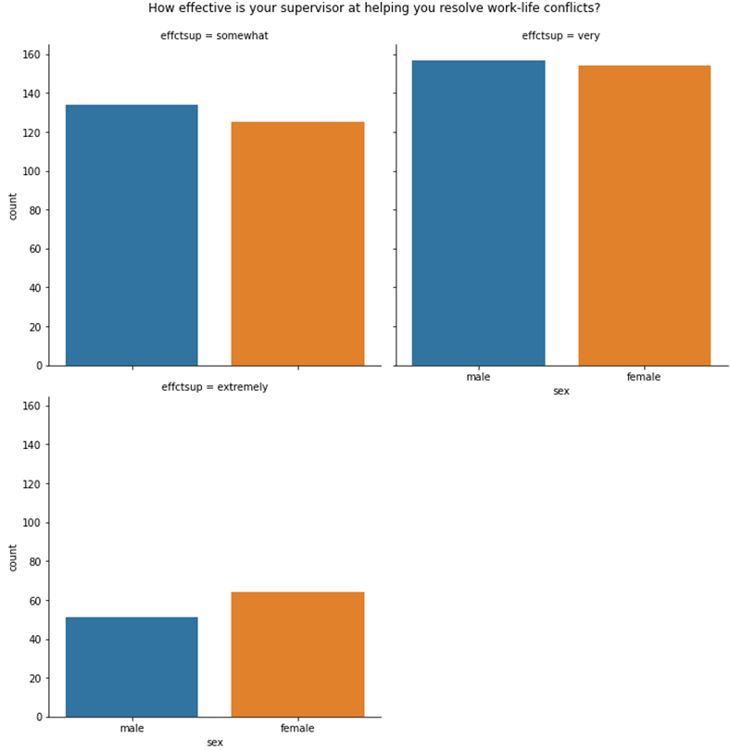
Test the third hypothesis (continued)

Slide 53
Conclusion for the third hypothesis
The data does not support the hypothesis. It is not clear that more women than men think their supervisors are effective when helping them resolve work-life conflicts.

